Slide 1
Interpopularity
for
Omnilateralism
Dr Wolfgang PAPE
Bruxelles
Dr Wolfgang PAPE,
Bruxelles
wolfgang.pape@gmail.com
[Draft]

Slide 2
What is
Interpopular?
Relations across borders between peoples under private law (contracts: trade, tourism …)
=/=
International = Relations between nations
under public law (treaties: diplomacy, UN …)

Slide 3
Narrow-minded inter-national relations often fail ( >WARS! ).
Open inter-popular relations prosper (tourism, trade, NGOs, Internet, …

Slide 4
Supranational Democracy Dialogue in Brindisi (Italy)
Countless references to “nation” in focus:
from nationality, subnational to international etc.
but hardly mention of the people = demos, although the people rule in democracy and should be in focus of the conference as a dialogue between academics => inter-popular (but not representing nations inter-nationally)

Slide 5
Supranationality=Pooling MS Sovereignty for Exclusive Competences of EU (“sui generis”) to rule:
Customs Union (e.g. tariffs, anti-dumping, WTO)
Common Commercial Policy
International trade agreements (FTAs Japan, SK)
Competition law (state aid; e.g. Google fined > 4 bio € )
Monetary policy for Euro-Zone, €
Resources under fisheries policy

Slide 6
Trump the Mixer
(not Fixer)
From Venezuela to Greenland, Gaza and Iran, in transactional conflicts of interest (plutocracy) Trump mixes roles:
private law “deal-maker” of “give and take” for agreements (contracts?)
public law negotiator as national President threatening forced “take-over” (treaties?)

Slide 7
Need to distinguish:
Relations between formal nations (with monopoly on violence) => international treaties
Relations between private people
(with equality before the law) => interpopular contracts

Slide 8
AI confirms:
“The term ‘interpopular’ refers to relationships and interactions among people across borders, emphasizing people-to-people connections rather than official national representations. Interpopularity highlights collaborations and communication among individuals and civil society groups, such as NGOs that transcend national boundaries…
’Interpopular’ emphasizes the importance of the collective voice and interests of people globally.”
(sic Chatbase.co, 2025/01/22)

Slide 9
“Nation”?
Since Peace of Westphalia (1648, “Religio et Regio”), nation in focus of civilisation with “monopoly on violence” (Max Weber) leading to countless wars and imposition by Europeans on other continents through colonisation etc.
Undefinable and unequal ‘nations’ (China=/=Nauru; Pres.=/=PM!) still core issue for wars in Ukraine, Gaza, Iran …cont.

Slide 10
Inter-national law = Western biased from start
In ”Mare Liberum” (1609), Hugo Grotius, thus founder of international law, affirmed Dutch sea-faring rights in ‘East Indies’ challenging claims of other colonisers (esp. Port.+Spain) which were monopolising trade there.
Then, on most continents Western colonisers’ drew new frontiers which later with “independence” became borders of “sovereign nations” in UN
=> multilateral ‘Westphalian System’

Slide 11
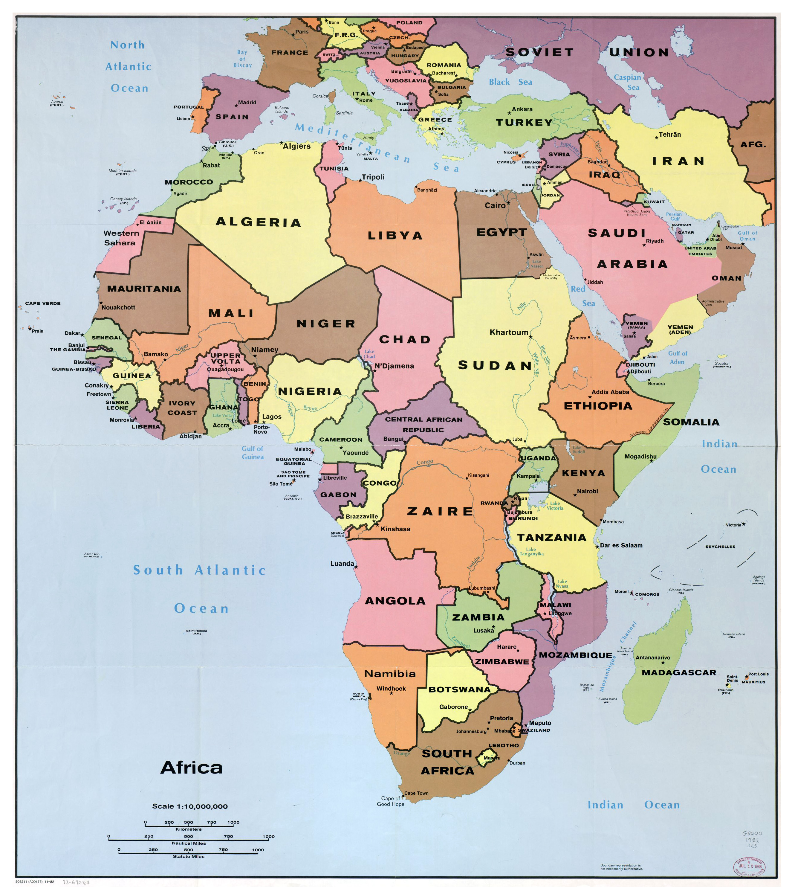
“National” but not natural borders drawn mainly by European colonisers, e.g. in Africa, America, Asia

Slide 12
Nation of ‘natives’ =/=> 国?
A most frequent character 国 (with 王 = king) invariably translated as nation, country, land, province, state (国家) etc. (Taiwan?)
Chinese: 中国 literally ‘Middle Kingdom’, but since millennia in soft concentric Mandala form administrating people now with 56 self-declared “nationalities”
Japanese: multi-lateral = 多国 = multi-national(s)
      国際(きわどい）＝international (= dangerous?)
Nation and inter-national law (国際法) invariably imposed on world by divisive Western colonialism, but old script (symbol) survives in East Asian undertstanding.
Notes:
際どいkiwadoi = dangerous, adventurous, indecent
Who in the room is a native of this “NATION” of Belgium?

Slide 13

United Nations
(function(){/* Copyright The Closure Library Authors. SPDX-License-Identifier: Apache-2.0 */ var a=document.getElementById("imi"),b=+a.getAttribute("data-w"),c=+a.getAttribute("data-h"),d,e=document.getElementById("imp"); d={g:Math.min(e.clientHeight-32,(window.VisualViewport?{g:document.documentElement.clientHeight,w:document.documentElement.clientWidth}:.05>Math.abs(document.documentElement.clientWidth/document.documentElement.clientHeight-window.innerWidth/window.innerHeight)?{g:window.innerHeight,w:window.innerWidth}:{g:document.documentElement.clientWidth*window.innerHeight/window.innerWidth,w:document.documentElement.clientWidth}).g),w:e.clientWidth-32};d.g-=94;b>d.w&&(c=c*d.w/b,b=d.w);c>d.g&&(b=b*d.g/c,c=d.g); var f=.3*(d.g+32);a.style.height=c+"px";a.style.width=b+"px";a.style.margin=(f>c?(f-c)/2:0)+"px 0";}).call(this); 2000 × 1333
By name UN and membership of 193 nations (although its Charter: “We the peoples…“?), the prime organisation of internationalism, has no clear definition of the“nation“!
Governments of the self-chosen 193 members decide on new members for this closed club of “states“ (issue of people of Palestine, Taiwan = 国 ?)
Un-UN‘s P5 with vetos not stopping but making war!

Slide 14
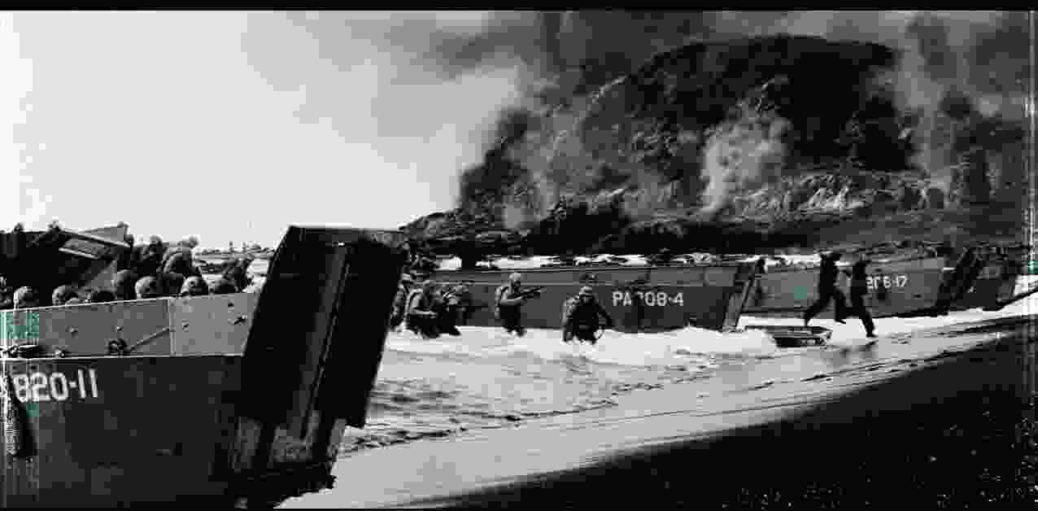
Wars between nations over centuries since Westphalian System, with weapons made of steel and disastrous energy, not only in Europe …

Slide 15
European
Coal and Steel Community
“La solidarité …manifestera que toute guerre … devient … impossible”
Schuman Declaration 1950-05-09
Peace Nobel Prize 2012 for EU
Obama: EU as… “one of the greatest political and economic achievements of modern times.”(INYT, 2.8.16)
15

Slide 16
How to avoid War?
Like Robert Schuman’s integration of coal and steel industries into public supranational governance (ECSC) for lasting peace in the EU, cross-border civic people (e.g. NGOs) should be progressively recognised in transnational law and included in global governance (cf. proposals by UN Sec.Gen. António Guterres).
Westphalian multilateralism of only nations would advance to inclusive omnilateralism, governance omnibus, for and by all legitimate people

Slide 17
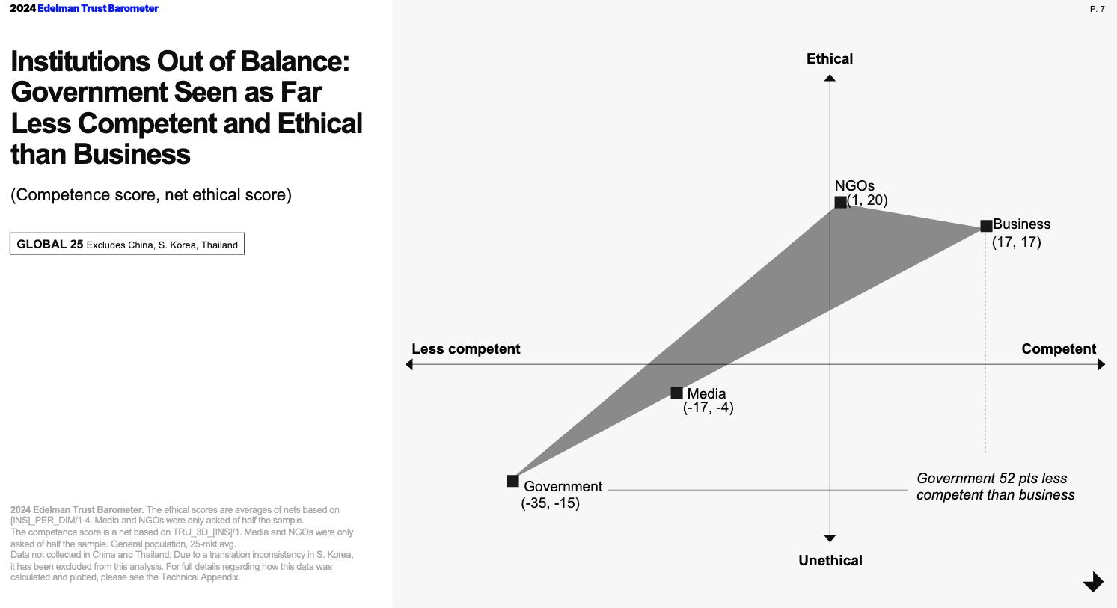
People in Business and NGOs seen as far more Competent and Ethical than Government (= nation)
(2024 Edelman Trust Barometer, Global, 65 countries)
=> Interpopularity
Notes:
Competent = yuunou 有能

Slide 18
NGOs vs. Nations
Nations: under public law with the monopoly on violence; acting cross-border only under official treaties or in … war!
NGOs: (as Non-Governmental => never international!) still registered in each nation separately and with only private law agency + personal liability, under contracts (Few NGOs additionally “accredited” with consultative ‘voices’ at EESC of EU or ECOSOC of UN; also ASEAN)
NGOs: not legally organised “internationally”, but acting across borders interpopularly; e.g. only “consulted” at EU, UN, COP etc.
NGOs: not with the quantity of formal votes, but rather with quality of convincing voices,

Slide 19
Logic of Inter-national Relations towards
Omni-lateralism
  (cf. in WTO)
  Uni- (by only 1 nation 国, e.g. USA of Trump, Rus Putin)
  Bi- ( 2, e.g. FTA between China and CH, Spaghetti Bowl, against SME)
  Tri- ( 3, e.g. China-Japan-Korea, Summit 2024 in Seoul ?)
  Pluri- (more than 3, e.g. TiSA of 23 in WTO; EU?)
  Multi- (many, only accepted “nations”, 193 in UN-GA)
  Omni- (incl. all NGO stakeholders; omnibus = for and by all, beyond “nation”) cf. I. Kant “allseitig” in “Metaphysik der Sitten” 1785

Slide 20
Legitimate democracy by people’s participation: “From quantity of votes to more quality of voices”
Local: most direct democracy because of proximity of issues (interests; e.g.“pool or theatre?” by 1person-1vote)
Provincial
National: Brexit, DT
Regional
Global: least direct participation possible because of comprehensiveness of ‘mediated’ issues
=> need science + omnilateral stakeholders’ voices, cf. COP (values; e.g. “climate change?”)
Increasing
market+media
dependence
(GAFA,BATX)
Notes:
Cf. Judiciary with juries of direct people’s participation at local courts, but not highest courts; D referendum only in Land

Slide 21


Future?
Omnilateralism advances all-inclusive global governance from only inter-national towards widely inter-popular monitory (not monetary!) democracy of all stakeholders following the UN Charter’s
“We the peoples …”

Slide 22
“Interpopular” into Wikipedia?
Neologisms like “interpopular” need references in published texts to find acceptance by the moderation of Wikipedia
Please, send me any references wherever you use or encounter “interpopular”!
With pleasure, I will send you my digital book on Omnilateralism in return.

Slide 23
My “Memo-Thesis” (600 pages) digitally upon request:
Opening to Omnilateralism
Democratic governance for all, from local to global with stakeholders
汎地球主義 全边主義”
AuthorHouse UK, 2021
Thank you 謝 !
http://omnilateralism.blogspot.com
고맙습니다
wolfgang.pape@gmail.com

Slide 24
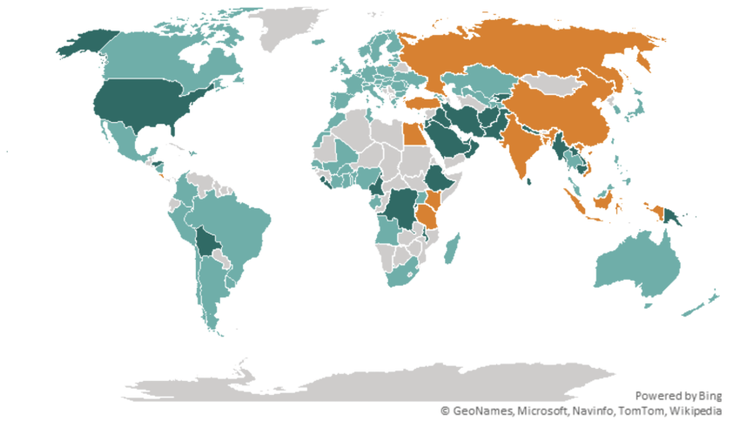
Alliances of data protection do not follow Factory Regions Source: ECIPE using data from Ferracane and van der Marel (2024). The American model is marked in dark green, the European model in light green, and the China model in orange.
Membership in “Factory Asia,” for example, does not automatically translate into adherence to China’s data rules: Cambodia and Thailand follow different regulatory paths. Nor do close manufacturing partners of the European Union necessarily adopt EU standards. Turkey and Egypt, despite deep trade ties with Europe through integrated supply chains, operate data-protection regimes more closely aligned with China’s approach. Conversely, both Canada and Mexico, integral parts of “Factory North America”, have adopted frameworks broadly aligned with the EU model.
What data governance reveals, then, is not a narrow regulatory debate but the emerging architecture of globalisation itself. Across artificial intelligence, advanced semiconductors, and frontier research, international cooperation increasingly rests on shared rules, trusted institutions, and political alignment. U.S. cooperation with Japan and Korea illustrates this shift.[2] Through dedicated technology partnerships, the United States has committed to deepening joint research in areas ranging from artificial intelligence to quantum computing, explicitly grounding that cooperation in shared standards and mutual trust with the two countries.

Slide 25
World economy is shifting away from a system built on factories and physical goods toward one increasingly driven by intangible assets such as data, services, intellectual property, and knowledge-based collaboration.
Despite recent transatlantic frictions, the European Union and the United States continue to rank among the world’s strongest systems of rule of law, regulatory enforcement, and accountability. These are foundations that support unparalleled levels of bilateral investment in intangible and idea-based activities. Although governance quality has shown signs of backsliding on both sides of the Atlantic, both partners have demonstrated a capacity to bridge differences, as illustrated by the recent adoption of the EU–U.S.A. Data Privacy Framework.

Slide 26
Sec-Gen Guterres’ vision for Civil Society, NGOs in UN:
(7 May 2021)
Upon question from EU on his idea of a “more inclusive UN”, he identified a need for:
“…a mechanism to make sure that we integrate [civil society] contributions in our strategic thinking, in our decision-making”
NGOs from private voices to counting votes in public governance => monitory democracy?
Recently, 50 nations and over 200 NGOs supported #UNmute initiative calling for a Special Envoy for Civil Society for participation across UN as these NGOs work transborder, i.e.
interpopularly

Slide 27

Levels of Democratic Governance:
Local village: most direct, transparent, informed
Province: parliamentary governance = filtered
Nation: finer 2 filters, but most borders by war => “ID”; sovereignty lost up- and downstream in war- and welfare through globalisation and subsidiarity “Nation =>historic aberration”
(government seen as "least trusted”)
Region: ASEAN, AU, Mercosur, NAFTA; CTPP, Trilateral 日中韓…
as inter-governmental;
only EU as supra-national by pooling sovereignty for exclusive competences (from member states),
EU Parliament directly elected by the people
Notes:
Supranationality of only governmental power, but for Non-Governmental Agency => interpopularity

Slide 28
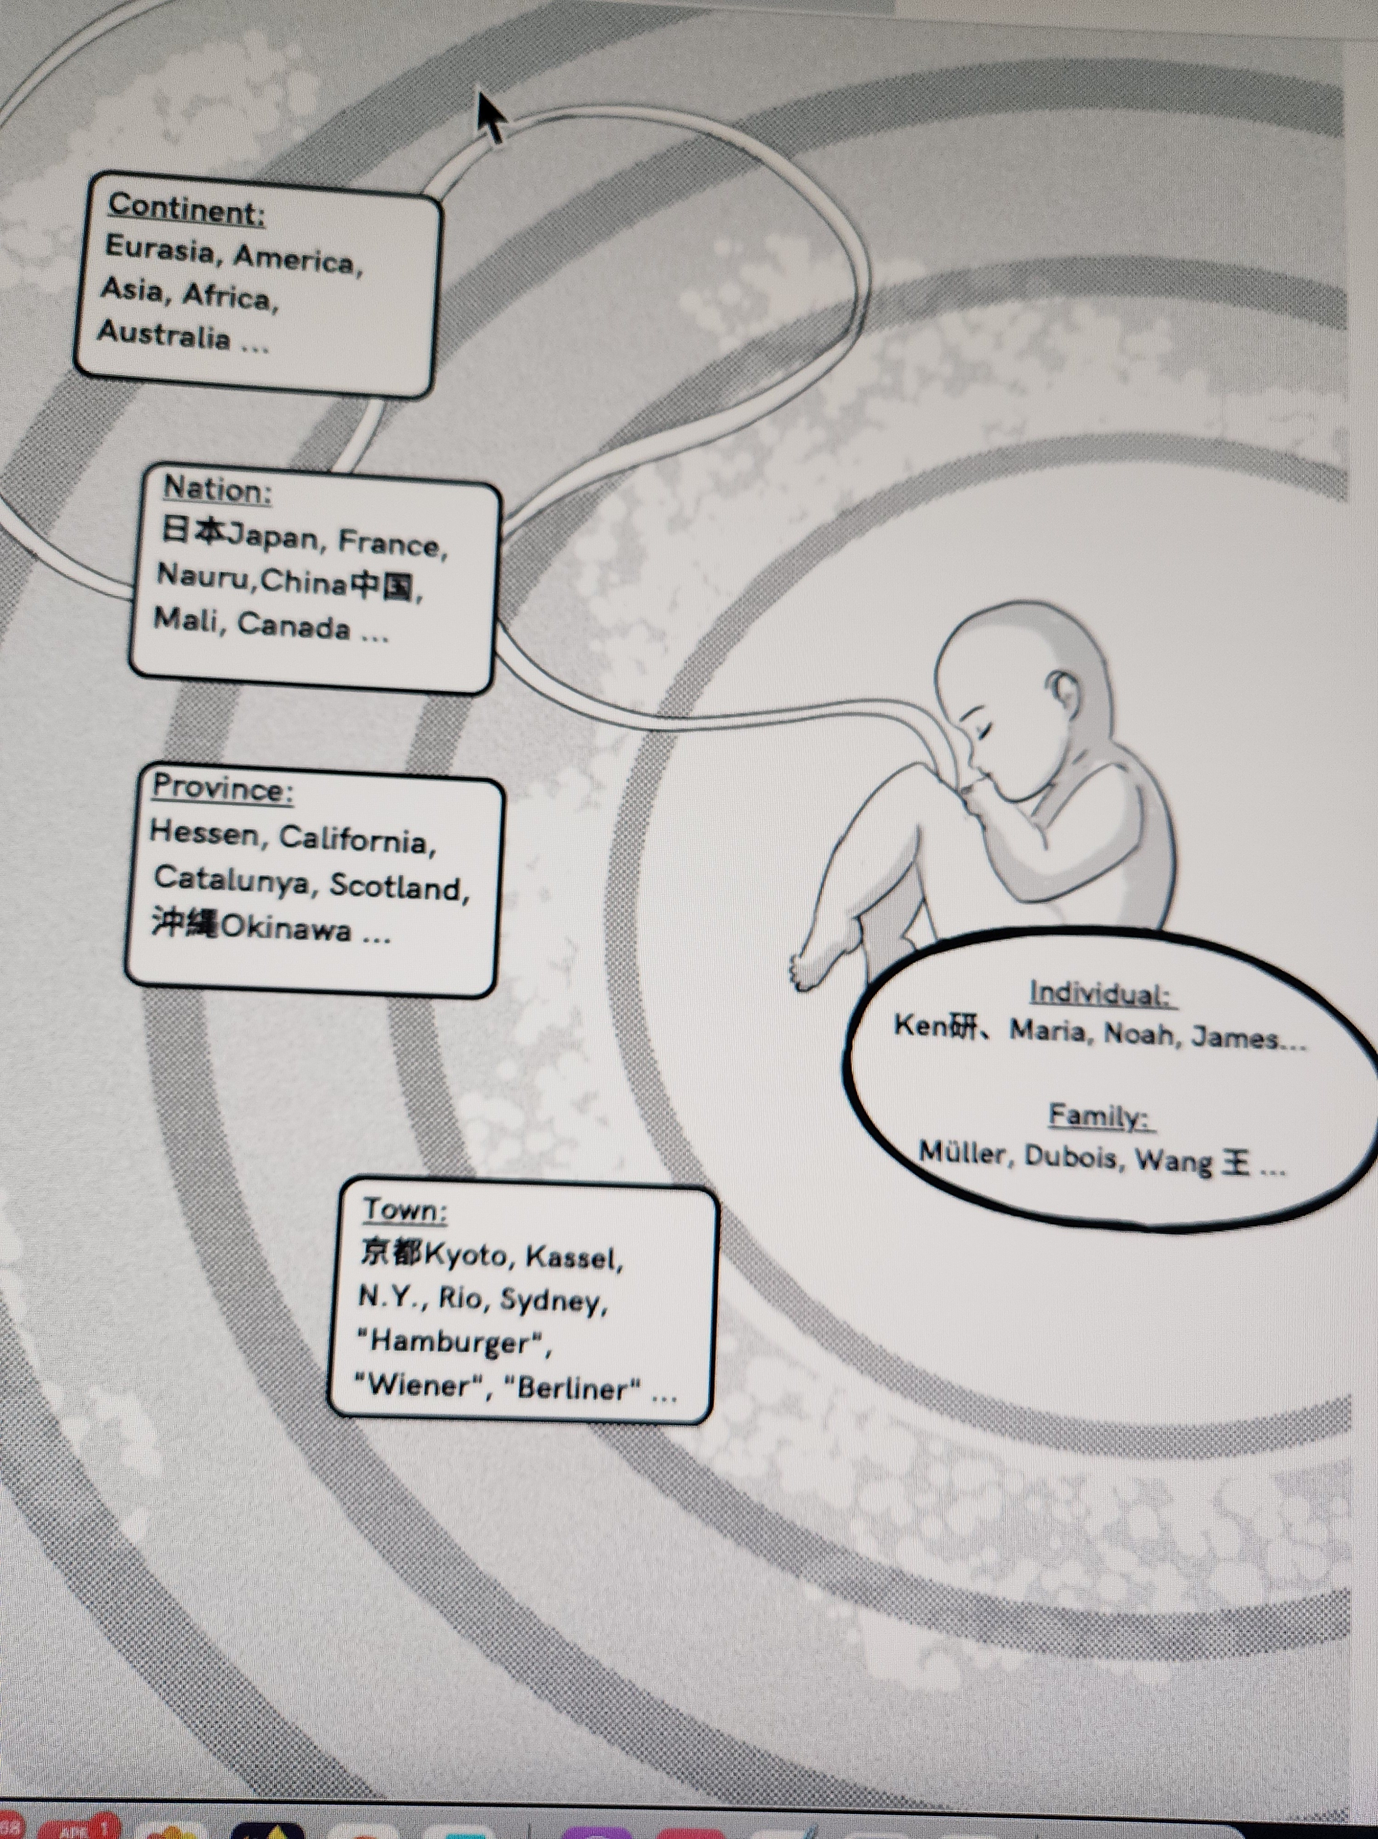
“ID” in Concentric Circles

